Slide 1
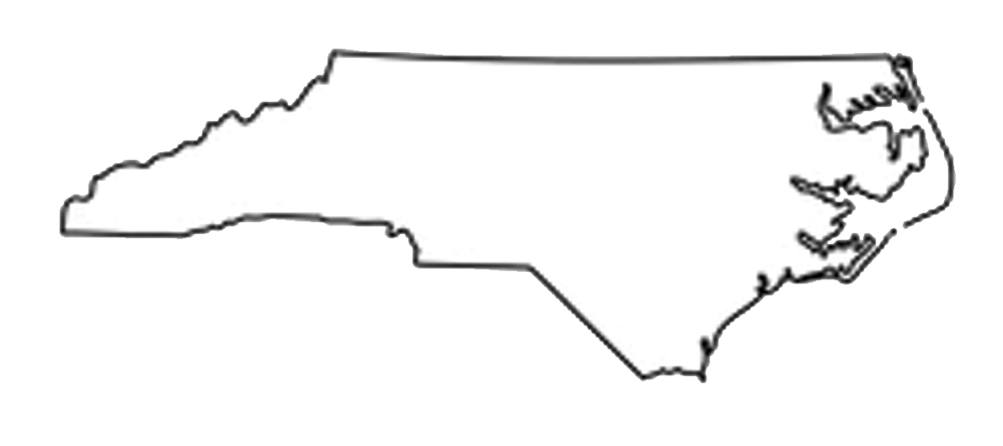
North Carolina Military Business Center:
Introduction to Federal Contracting
May 2024
“Should my company consider Department of Defense business opportunity and
how does my company get started?”
Scott Dorney
scott@ncmbc.us
Lee Moritz
moritzl@ncmbc.us
ncmbc.us DEFTECH.nc.gov MatchForce.org
Notes:
Intro…and thank you for the invitation

Slide 2
Agenda
Help you accomplish missions, meet Directorate requirements
Drive competition, drive down costs, beat small business goals
Engage businesses to work for the military
Provide market intel, business development, training and one-on-one technical assistance (pre- and post-award)
Promote employment: transitioning military & families
Promote installation/command - community relations
Federal market overview
Positioning your business to engage
How the government purchases goods and services
Federal contracting – business development programs
Leveraging the market
Getting started in the market
Finding opportunities and next steps
Notes:
This is a business decision. In the short time today I wanted to provide you with an overview of the business opportunity.
It may not be for your business. I did prepare this deck so if interested, you could pass this on to a company team member to get you started. The deck includes website references and checklist references that can assist you.

Slide 3
The Opportunity
Help you accomplish missions, meet Directorate requirements
Drive competition, drive down costs, beat small business goals
Engage businesses to work for the military
Provide market intel, business development, training and one-on-one technical assistance (pre- and post-award)
Promote employment: transitioning military & families
Promote installation/command - community relations
Each year, the Defense Logistics Agency (DLA) issues over $35 billion in contracts to meet the needs of the warfighter and federal agencies
DLA Issues 10,000 contracts per day for 100,000 line items
DLA Clothing and Textiles awarded over $1 Billion in textile purchases in FY23
DLA C&T seriously wants to expand supplier base – primes and subs
The government goal: award 23 percent of all contracts to small business
Notes:
Located in Phily. DLA Aviation
Land and Maritime
Troop Support- (Clothing and Textiles, Construction, Subsistence (food), Medical) – FY 22 19.2 billion dollars in purchases
Energy
Business Systems

Slide 4
Federal Textiles Opportunities
FY 23 – Over 5000 Solicitations for all Textiles to include bedding and furniture
FY23, NC business were awarded 4.8% of federal textiles purchase dollars* - 7th in US
Top 6: FL, VA, KY, CA, TN, PR
DoD concern - shrinking textile industrial base
Some supply chains are “one deep”
Notes:
Total textile companies- Texas, California then North Carolina
Awards- 1. Virginia 2. Illinois 3. Florida 4. Massachusetts 5. North Carolina
FY23 = 5202 by NAICS alone
North Carolina (2,058 businesses), California (1,595 businesses) and Georgia (1,102 businesses) are the States with the most number of Textile Mills businesses in the US.

Slide 5
So Who is the NC Military Business Center?
Help you accomplish missions, meet Directorate requirements
Drive competition, drive down costs, beat small business goals
Engage businesses to work for the military
Provide market intel, business development, training and one-on-one technical assistance (pre- and post-award)
Promote employment: transitioning military & families
Promote installation/command - community relations
NCMBC is a statewide, business development and technology transition entity of the State of North Carolina, embedded in community colleges and headquartered at Fayetteville Technical Community College
NCMBC primary task - connect NC businesses with DoD opportunities; help pursue, win and execute
Totally State-funded (and important to note), the NCMBC is the only statewide, military focused economic development entity in the US
Notes:
NCMBC purpose is to inform NC businesses about these opportunities; help them pursue and win them and support the successful execution of these contracts
Successful execution will lead to growing number of contract wins
“Success begets success”
Only statewide agency….formed in 2005

Slide 6
Mission, Objectives and Impact
Help you accomplish missions, meet Directorate requirements
Drive competition, drive down costs, beat small business goals
Engage businesses to work for the military
Provide market intel, business development, training and one-on-one technical assistance (pre- and post-award)
Promote employment: transitioning military & families
Promote installation/command - community relations
NCMBC Mission: To leverage military and federal business opportunities to expand the economy, grow jobs and improve quality of life
4 Key Objectives:
- Increase federal revenues for businesses
- Support integration of separating military into NC workforce
- Support defense-related business recruitment
– Introduce new technologies to federal agencies
Outcomes: Contracts (5,619), revenues ($17.89b) = NC jobs!

Slide 7
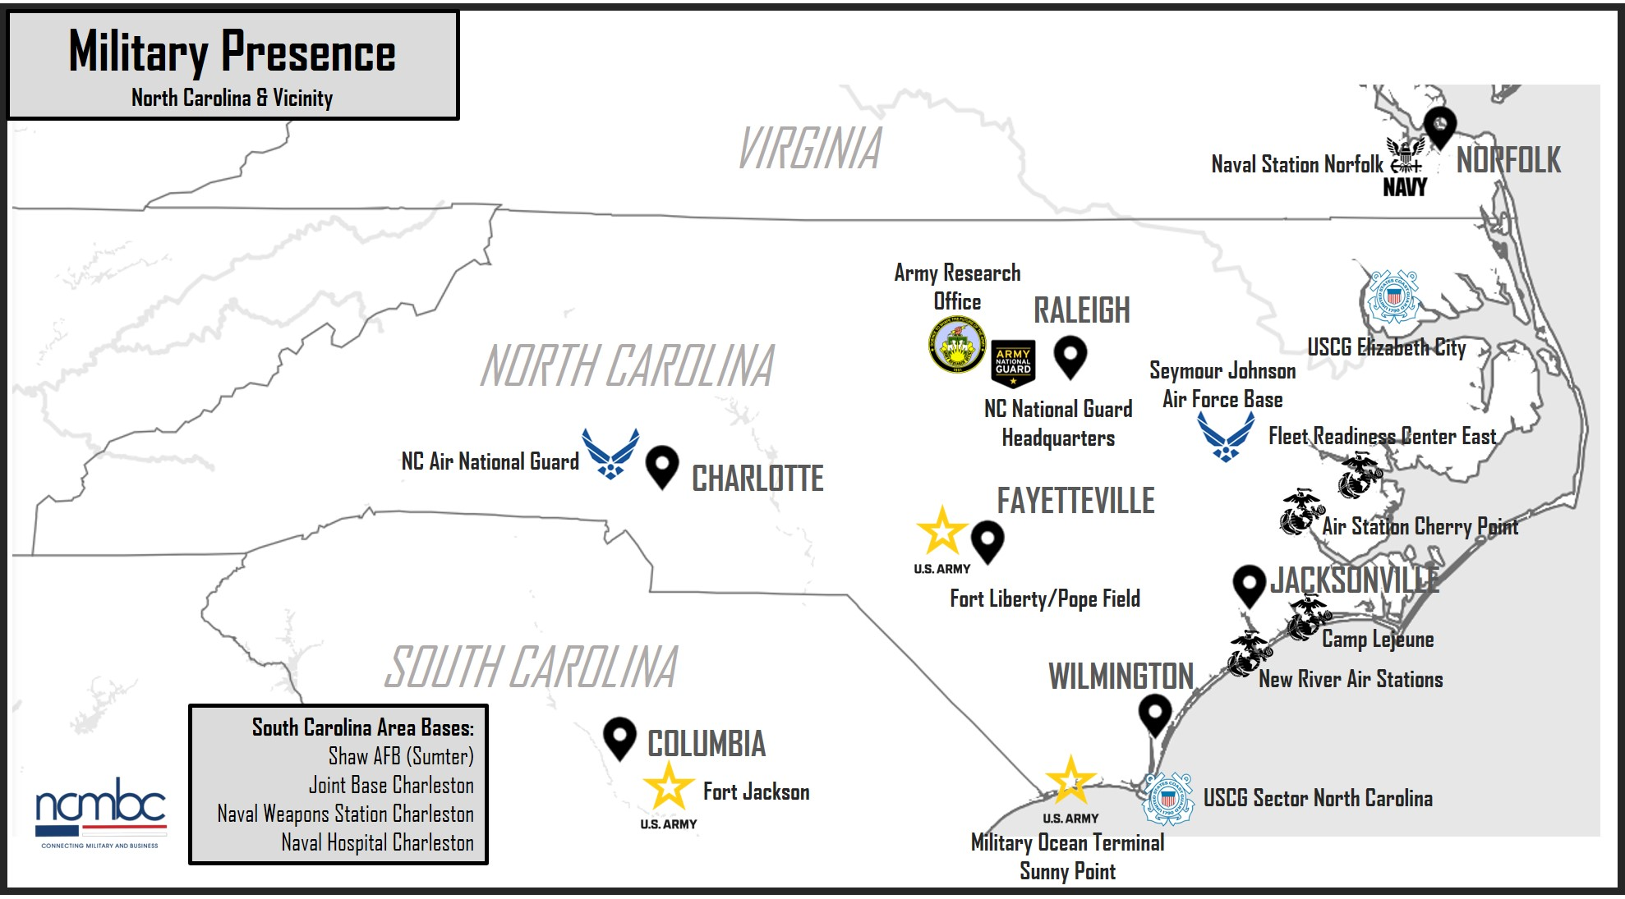
NC Military Presence
4th highest active duty military presence in US
6 major installations (5 DoD/1 DHS)
Over 100 National Guard & Reserve facilities
130,000 Active, Guard and Reserve personnel
18,000 annual transition from the military in NC

Slide 8
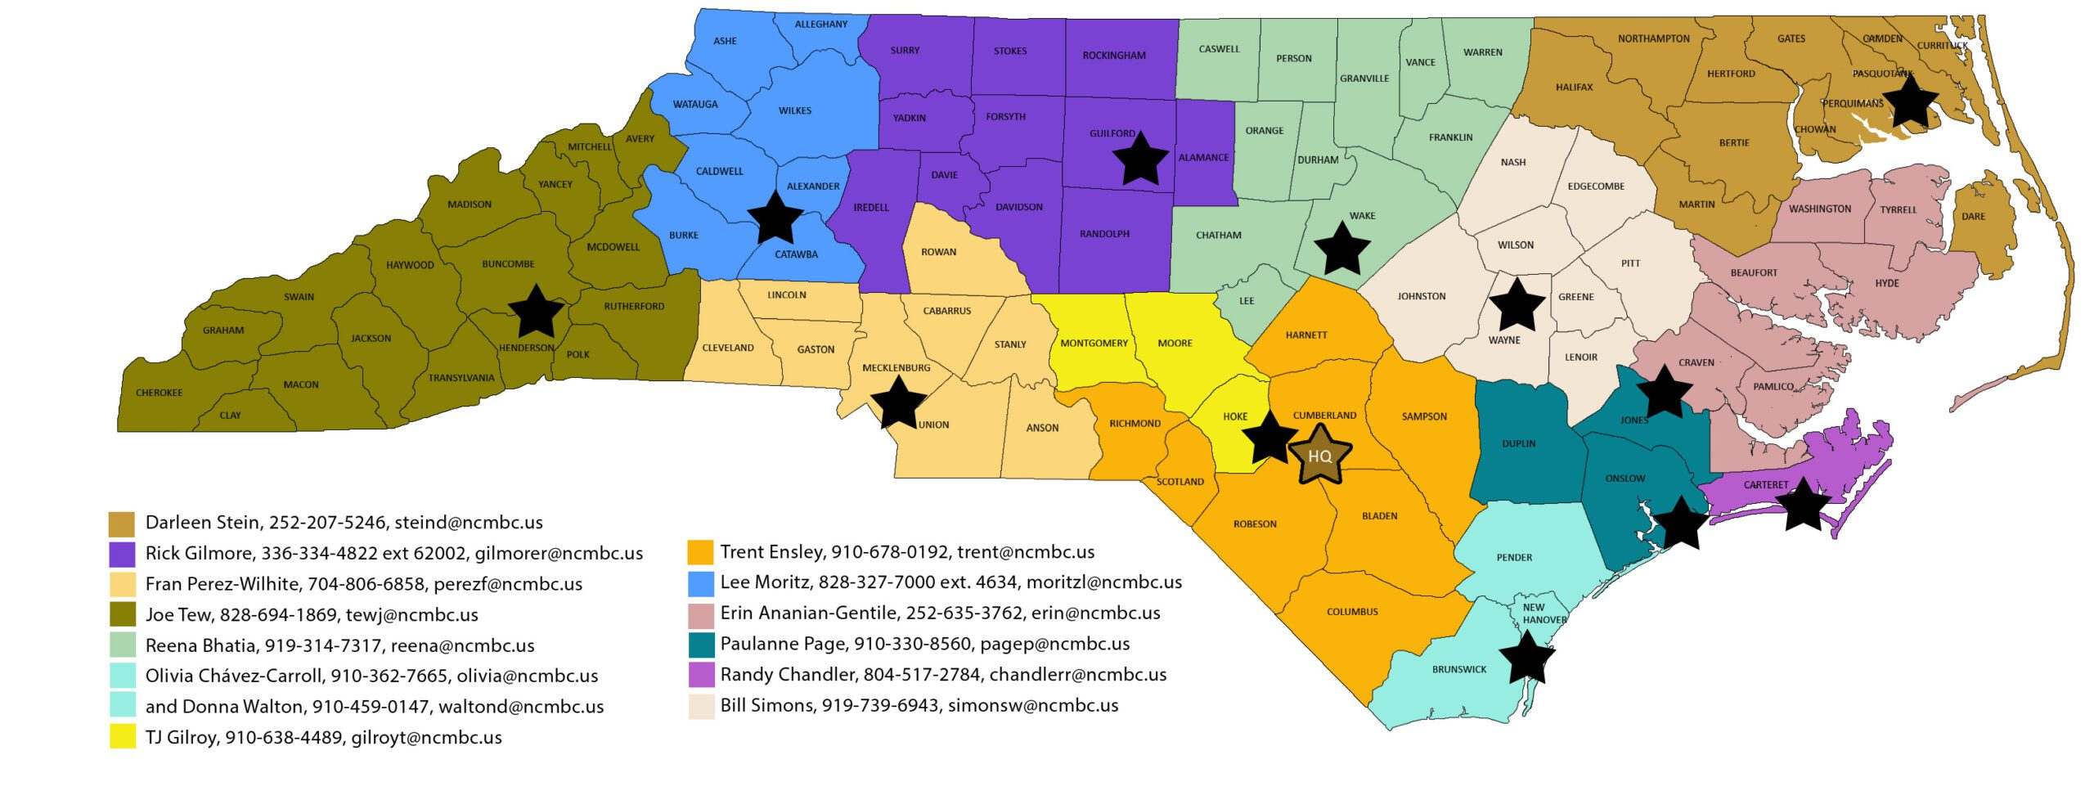
NCMBC BD Team Locations
Help you accomplish missions, meet Directorate requirements
Drive competition, drive down costs, beat small business goals
Engage businesses to work for the military
Provide market intel, business development, training and one-on-one technical assistance (pre- and post-award)
Promote employment: transitioning military & families
Promote installation/command - community relations
Notes:
Busy Slide- added for reference…
State divided into Geographical areas….then overlap by Industry Professionals

Slide 9
North Carolina Textile Facts
Help you accomplish missions, meet Directorate requirements
Drive competition, drive down costs, beat small business goals
Engage businesses to work for the military
Provide market intel, business development, training and one-on-one technical assistance (pre- and post-award)
Promote employment: transitioning military & families
Promote installation/command - community relations
Defense: second largest sector of the NC economy
State designated “DoD Defense Manufacturing Community”
NC is home to 600+ textile manufacturers
456 prime textile product and service businesses
179 providers of textile products to federal agencies
NC is the recognized leader in textile innovation and manufacturing
Wilson College of Textiles, NC State University
Nonwovens Institute, NC State University
Manufacturing & Textile Innovation Network
Notes:
What is #1 business sector for North Carolina?- Agriculture
Recognized across DOD as the innovation leader for textiles

Slide 10
OK I’m interested, now what?
Help you accomplish missions, meet Directorate requirements
Drive competition, drive down costs, beat small business goals
Engage businesses to work for the military
Provide market intel, business development, training and one-on-one technical assistance (pre- and post-award)
Promote employment: transitioning military & families
Promote installation/command - community relations
To sell your products or services to the federal government, your business must meet specific requirements
Although the contracting process can seem complicated and overwhelming at first, the government provides information and tips to help you learn to compete as a federal contractor
Notes:
As I go through these slides, you might feel as if you are drinking from a fie hose! That’s OK

Slide 11
Positioning Your Business to Engage
Help you accomplish missions, meet Directorate requirements
Drive competition, drive down costs, beat small business goals
Engage businesses to work for the military
Provide market intel, business development, training and one-on-one technical assistance (pre- and post-award)
Promote employment: transitioning military & families
Promote installation/command - community relations
Be willing to embrace technology, automation and ecommerce
Best for firms with at least two years in business
Good record of experience and (good) past performance - commercial and/or subcontracting past performance
Must be competitive and technically and financially capable
Highly competitive – great business but hard to forecast
Not a lifesaver for a struggling business - teaming often critical to getting started
Get in this for the long haul!

Slide 12
Positioning Your Business to Engage
Help you accomplish missions, meet Directorate requirements
Drive competition, drive down costs, beat small business goals
Engage businesses to work for the military
Provide market intel, business development, training and one-on-one technical assistance (pre- and post-award)
Promote employment: transitioning military & families
Promote installation/command - community relations
Research - Do the Homework
To bid on and win government contracts, you’ll need to know what products and services the government buys — and at what price. Spend time up front making sure there’s a market for your product(s) or service(s), determine how big the market is.
Federal Procurement Data System (FPDS) https://www.fpds.gov
The Federal Procurement Data System – a repository of all federal contracting data for contracts over $25,000. You can see which agencies have contracts and with whom, what agencies buy, and which contractors have these contracts.
Notes:
Everything the government does is open source unless classified.

Slide 13
Positioning Your Business to Engage
Help you accomplish missions, meet Directorate requirements
Drive competition, drive down costs, beat small business goals
Engage businesses to work for the military
Provide market intel, business development, training and one-on-one technical assistance (pre- and post-award)
Promote employment: transitioning military & families
Promote installation/command - community relations
USASpending.gov
USASpending.gov tracks government spending through the contracts it awards. This searchable database contains information for each federal contract. You can use this information to help identify government purchasing trends by state.
Federal agency procurement forecasts
Each government agency releases a procurement forecast that includes contracting opportunities for small businesses. You can review these Agency Recurring Procurement Forecasts to find out if there are agencies that buy what you sell. Data is also loaded on www.ncmbc.us future opps database – and flows to www.MatchForce.org.
Notes:
USAspending.gov is a good source to see the market……however just snapshot. Subject to change with global events.

Slide 14
How the Government Buys Goods and Services
Help you accomplish missions, meet Directorate requirements
Drive competition, drive down costs, beat small business goals
Engage businesses to work for the military
Provide market intel, business development, training and one-on-one technical assistance (pre- and post-award)
Promote employment: transitioning military & families
Promote installation/command - community relations
“Who’s Who” and “What’s What” in federal acquisition
User (with requirements)- the Warfighter
Contracting Office- (acquires goods, services for users)
Federal acquisition regulations (FARs)- Federal Law that Governs
Note: Every purchase begins with a determined requirement by the user
Notes:
Government is not a trend shopper
(Almost) everything begins with a determine requirement

Slide 15
How the Government Buys Goods and Services
Help you accomplish missions, meet Directorate requirements
Drive competition, drive down costs, beat small business goals
Engage businesses to work for the military
Provide market intel, business development, training and one-on-one technical assistance (pre- and post-award)
Promote employment: transitioning military & families
Promote installation/command - community relations
Prioritized sourcing for DOD Textiles
1.Agency internal inventories
2. Other agency excess inventories
3. Federal Prison Industries
4. Ability One
5. Wholesale supply sources (Defense Logistics Agency, DLA)
6. General Services administration, mandatory, then optional federal supply schedules (GSA)
7. Commercial Sources
Notes:
This slide just illustrates that the government tries to be good stewards on the taxpayers money. This priority scrub happens before any of us sees the opportunity.
Priorities 5, 6 and 7 will be opportunities.

Slide 16
How the Government Buys Goods and Services
Help you accomplish missions, meet Directorate requirements
Drive competition, drive down costs, beat small business goals
Engage businesses to work for the military
Provide market intel, business development, training and one-on-one technical assistance (pre- and post-award)
Promote employment: transitioning military & families
Promote installation/command - community relations
Appropriated funds
Government seeks to give all businesses a fair chance to compete- Set Asides
Government may use “best value” - may not be the lowest price
Purchasing Laws are followed in accordance to:
Code of Federal Regulation
Federal Acquisition Regulation (FAR)
Defense Federal Acquisition Regulation (DFAR), or…
Other Federal Agency Supplements
Notes:
Emphasize there can be exceptions to these thresholds
Government Credit Cards- We have a company here in NC that make part of their business model is to visit units on base and sell direct.
NC Sock client has a unique product and has been successful with this business strategy. Visits units on base.

Slide 17
How the Government Buys Goods and Services
Help you accomplish missions, meet Directorate requirements
Drive competition, drive down costs, beat small business goals
Engage businesses to work for the military
Provide market intel, business development, training and one-on-one technical assistance (pre- and post-award)
Promote employment: transitioning military & families
Promote installation/command - community relations
Appropriated funds
Micro Purchases – Up to $10,000
Buyer only has to solicit one source
Price must be reasonable
Usually paid by Government Purchase Card (GPC)
Many federal employees have GPC’s and make small purchases everyday
Notes:
Emphasize there can be exceptions to these thresholds
Government Credit Cards- We have a company here in NC that make part of their business model is to visit units on base and sell direct.
NC Sock client has a unique product and has been successful with this business strategy. Visits units on base.

Slide 18
How the Government Buys Goods and Services
Help you accomplish missions, meet Directorate requirements
Drive competition, drive down costs, beat small business goals
Engage businesses to work for the military
Provide market intel, business development, training and one-ce (pre- and post-award)
Promote employment: transitioning military & families
Promote installation/command - community relations
Appropriated funds
Simplified Acquisition Threshold (SAT), up to $25,000
Set–aside for small business (SB)
Handled by (on base) contracting officers
3 quotes from vendors they know and locate
Award based on low best price/delivery requirements
Notes:
Reduces administrative burdens……Give contracting options for commercial purchases…….Help Set Asides……Compares quote and prices
Must go to a Small Business

Slide 19
How the Government Buys Goods and Services
Help you accomplish missions, meet Directorate requirements
Drive competition, drive down costs, beat small business goals
Engage businesses to work for the military
Provide market intel, business development, training and one-on-one technical assistance (pre- and post-award)
Promote employment: transitioning military & families
Promote installation/command - community relations
Appropriated funds
Simplified Acquisition Threshold (SAT), $25,000 - $250,000*
Usually set aside for small business (SB)
May use ”Best Value,” not always the lowest price
Solicitations posted and competed on SAM.gov (MatchForce!)
* Exceptions to the limit exist for contingency operations, disaster prevention/response/recovery
Notes:
Posted as a competitive bid.
Must go a Small Business

Slide 20
How the Government Buys Goods and Services
Help you accomplish missions, meet Directorate requirements
Drive competition, drive down costs, beat small business goals
Engage businesses to work for the military
Provide market intel, business development, training and one-on-one technical assistance (pre- and post-award)
Promote employment: transitioning military & families
Promote installation/command - community relations
Appropriated funds
Purchases over $250,000
Subject to other federal business development programs/ Set Asides
Past Performance will be one factor in the decision process
May require a technical proposal
More formal process - Please note: companies must follow instructions in the Request for Quote (RFQ) or Request for Proposal (RFP)
Notes:
Pay particular attention to what the government is asking and only answer those questions.
This is not the time to add why your product is better, ect. Keep in mind most contracting officers don’t even fully understand textiles. Answer the questions, give your best quote and stop!

Slide 21
Business Development Programs “Set Asides”
Help you accomplish missions, meet Directorate requirements
Drive competition, drive down costs, beat small business goals
Engage businesses to work for the military
Provide market intel, business development, training and one-on-one technical assistance (pre- and post-award)
Promote employment: transitioning military & families
Promote installation/command - community relations
Federal Government has instituted business development programs to meet national policy goals.
Advantages to certifying your company:
Could receive a contracts on a “sole source” basis meaning no competition.
Will only compete with similar firms
May get a price preference
Helps the Government agency meet its goals
Helps prime contractors meet their goals

Slide 22
Business Development Programs
Help you accomplish missions, meet Directorate requirements
Drive competition, drive down costs, beat small business goals
Engage businesses to work for the military
Provide market intel, business development, training and one-on-one technical assistance (pre- and post-award)
Promote employment: transitioning military & families
Promote installation/command - community relations
Small Business Concerns - 23% of all prime awards, with subsets:
HUBZone Small Business Concerns - 3% (dollar value of prime/sub awards)
Service-Disabled Veteran-Owned Small Businesses - 5% (dollar value of prime/ sub awards)
Small Disadvantaged Businesses - 5% (dollar value of prime/sub awards)
Women-Owned Small Businesses - 5% (dollar value of prime/sub awards)
Sources: US SBA, Federal Contracting, Contracting assistance programs https://www.sba.gov/federal-contracting/contracting-assistance-programs, 30 NOV 2023 and https://crsreports.congress.gov/product/pdf/IN/IN12018
Notes:
Next Slide shows them all…..

Slide 23
Business Development Programs “Being a Teaming Partner”
Help you accomplish missions, meet Directorate requirements
Drive competition, drive down costs, beat small business goals
Engage businesses to work for the military
Provide market intel, business development, training and one-on-one technical assistance (pre- and post-award)
Promote employment: transitioning military & families
Promote installation/command - community relations
Subcontracting Opportunities/Teaming
Federal subcontracts = commercial contract between two firms
Subcontracting plan required for awards when:
Contract value exceeds $750,000 ($1.5 million for construction)
SBCs can execute at fair market value, without disrupting performance
Large primes have goals for SBCs, HUBZone, SDVOSB, SDB, WOSBs, etc.
May be the best market for new contractors!
Access sub opportunities via NCMBC events, www.ncmbc.us, www.MatchForce.org, SBA Subnet
Notes:
Very Important
I teamed up with Lockeed Martin. It was great business and lasted 8 years.
They were the prime and we were issued a commercial contract from them.
We helped them meet their Set Aside requirements.

Slide 24
Top Textile Vendors to the Federal Government “Potential Teaming Partners”
Help you accomplish missions, meet Directorate requirements
Drive competition, drive down costs, beat small business goals
Engage businesses to work for the military
Provide market intel, business development, training and one-on-one technical assistance (pre- and post-award)
Promote employment: transitioning military & families
Promote installation/command - community relations
NAICS 315110 – HOSIERY AND SOCK MILLS
Pickett Hosiery Mills, Inc. (Burlington, NC)
Special T Hosiery Mills, Inc. (Burlington, NC)
Graham Dyeing & Finishing, Inc. (Burlington, NC)
Unfire, Inc (Spokane, WA)
NAICS 315999 – OTHER APPAREL, ACCESSORIES AND MANUFACTURING
Integrated Security Technologies, Inc. (Herndon, VA)
The Armored Group Limited Liability Company (Phoenix, AZ)
Quantico Tactical, Inc. (Aberdeen, NC)
Central Lake Armor Express (Eden, NC)
NAICS 316210 – FOOTWEAR MANUFACTURING
Belleville Shoe Manufacturing Company (Belleville, IL)
Capps Shoe Company (Lynchburg, VA)
McRae Industries, Inc. (Mount Gilead, NC)
Danner, Inc. (Portland, OR)
San Antonio Shoe Inc (San Antonio, TX)
NAICS 313210: BROADWOVEN FABRIC MILLS
Murdock Webbing Company, Inc. (Central Falls, RI)
Tabb Textiles Co., Inc. (Opelika, AL)
CME Arma, Inc. (Miami, FL)
MEM Corporation (White Plains, MD)
Federal Defense Industries, Inc. (Boerne, TX)
Notes:
List NAICS code descriptions and separate this into two slides. Remove surgical numbers.

Slide 25
Top Textile Vendors to the Federal Government “Potential Teaming Partners”
Help you accomplish missions, meet Directorate requirements
Drive competition, drive down costs, beat small business goals
Engage businesses to work for the military
Provide market intel, business development, training and one-on-one technical assistance (pre- and post-award)
Promote employment: transitioning military & families
Promote installation/command - community relations
NAICS 315210: CUT AND SEW APPAREL
ReadyOne Industries Inc (El Paso, TX)
Federal Prison Industries, Inc (Washington, D.C.)
Winston-Salem Industries for the Blind (Winston-Salem, NC)
Point Blank Enterprises (Pompano Beach, FL)
NAICS 315990: APPAREL ACCESSORIES AND OTHER MANUFACTURING
Atlantic Diving Supply, Inc. (Virginia Beach, VA)
Lost Arrow, Inc. (Ventura, CA)
Bethel Industries, Inc. (Jersey City, NJ)
Tactical & Survival Specialties, LLC (Harrisonburg, VA)
NAICS 313310: TEXTILE AND FABRIC FINISHING MILLS
Burlington Industries, LLC (Greensboro, NC)
Ametrine, Inc. (Rockville, MD)
Southern Mills, Inc. (Union City, GA)
Peckham Vocational Industries, Inc. (Lansing, MI)
Federal Prison Industries, Inc. (Washington, D.C.)
NAICS 314910: TEXTILE BAG AND CANVAS MILLS
Propper International, Inc. (Cabo Rojo, Puerto Rico)
Fibrotex USA Inc. (Washington, D.C.)
UTS Systems, LLC (Fort Walton Beach, FL)
Eagle Industries Unlimited, Inc. (Virginia Beach, VA)
Notes:
List NAICS code descriptions and separate this into two slides. Remove surgical numbers.

Slide 26
Top Textile Vendors to the Federal Government “Potential Teaming Partners”
Help you accomplish missions, meet Directorate requirements
Drive competition, drive down costs, beat small business goals
Engage businesses to work for the military
Provide market intel, business development, training and one-on-one technical assistance (pre- and post-award)
Promote employment: transitioning military & families
Promote installation/command - community relations
NAICS 315250: CUT AND SEW APPAREL MANUFACTURING
Kandor Manufacturing Inc (Arecibo, Puerto Rico)
Goodwill Industries of South Florida Inc (Miami, FL)
Pentaq Manufacturing, Corp. (Sabana Grande, Puerto Rico)
Roicom USA LLC (El Paso, TX)
M M Manufacturing LLC (Lajas, Puerto Rico)
NAICS 313110: FIBER, YARN, AND THREAD MILLS
American & Efird LLC (Mount Holly, NC)
Federal Prison Industries Inc (Lexington, KY)
Frham Safety Products, Inc (Nashville, TN)
Technology Holding LLC (Salt Lake City, UT)
NAICS 315280: OTHER CUT AND SEW APPAREL MANUFACTURING
Federal Prison Industries, Inc. (Washington, D.C.)
Winston-Salem Industries for the Blind (Winston-Salem, NC)
ML Click Marketing (Phoenix, AZ)
Mustang Survival Mfg, Inc. (Jacksonville, FL)
NAICS 315120: APPAREL KNITTING MILLS
American Apparel, Inc. (Selma, AL)
Viewsport, Inc. (Penfield, NY)
Industries of the Blind Inc (Greensboro, NC)
Puerto Rico Industries for the Blind (Mayaguez, Puerto Rico)
Arizona Industries for the Blind (Phoenix, AZ)
Notes:
List NAICS code descriptions and separate this into two slides. Remove surgical numbers.

Slide 27
Textile (and Furniture) NAICS Codes
Help you accomplish missions, meet Directorate requirements
Drive competition, drive down costs, beat small business goals
Engage businesses to work for the military
Provide market intel, business development, training and one-on-one technical assistance (pre- and post-award)
Promote employment: transitioning military & families
Promote installation/command - community relations
NAICS Code | Description | NAICS Code | Description
313110 | FIBER, YARN, AND THREAD MILLS | 337122 | NONUPHOLSTERED WOOD HOUSEHOLD FURNITURE MANUFACTURING
313210 | BROADWOVEN FABRIC MILLS | 337124 | METAL HOUSEHOLD FURNITURE MANUFACTURING
313220 | NARROW FABRIC MILLS AND SCHIFFLI MACHINE EMBROIDERY | 337125 | HOUSEHOLD FURNITURE (EXCEPT WOOD AND UPHOLSTERED) MANUFACTURING
313230 | NONWOVEN FABRIC MILLS | 337126 | HOUSEHOLD FURNITURE (EXCEPT WOOD AND UPHOLSTERED) MANUFACTURING
313240 | KNIT FABRIC MILLS | 337127 | INSTITUTIONAL FURNITURE MANUFACTURING
313310 | TEXTILE AND FABRIC FINISHING MILLS | 337211 | WOOD OFFICE FURNITURE MANUFACTURING
313320 | FABRIC COATING MILLS | 337212 | CUSTOM ARCHITECTURAL WOODWORK AND MILLWORK MANUFACTURING
314110 | CARPET AND RUG MILLS | 337214 | OFFICE FURNITURE (EXCEPT WOOD) MANUFACTURING
314120 | CURTAIN AND LINEN MILLS | 337215 | SHOWCASE, PARTITION, SHELVING, AND LOCKER MANUFACTURING
314910 | TEXTILE BAG AND CANVAS MILLS | 337910 | MATTRESS MANUFACTURING
314994 | ROPE, CORDAGE, TWINE, TIRE CORD, AND TIRE FABRIC MILLS | 337920 | BLIND AND SHADE MANUFACTURING
314999 | ALL OTHER MISCELLANEOUS TEXTILE PRODUCT MILLS | 339113 | SURGICAL APPLIANCE AND SUPPLIES MANUFACTURING
315110 | HOSIERY AND SOCK MILLS | 339920 | SPORTING AND ATHLETIC GOODS MANUFACTURING
315120 | APPAREL KNITTING MILLS | 339993 | FASTENER, BUTTON, NEEDLE, AND PIN MANUFACTURING
315190 | OTHER APPAREL KNITTING MILLS | 339999 | ALL OTHER MISCELLANEOUS MANUFACTURING
315210 | CUT AND SEW APPAREL CONTRACTORS | 442110 | FURNITURE STORES
315220 | MEN'S AND BOYS' CUT AND SEW APPAREL MANUFACTURING | 442299 | ALL OTHER HOME FURNISHINGS STORES
315240 | WOMEN'S, GIRLS', AND INFANTS' CUT AND SEW APPAREL MANUFACTURING | 448110 | MEN'S CLOTHING STORES
315250 | CUT AND SEW APPAREL MANUFACTURING (EXCEPT CONTRACTORS) | 448120 | WOMEN'S CLOTHING STORES
315280 | OTHER CUT AND SEW APPAREL MANUFACTURING | 448130 | CHILDREN'S AND INFANTS' CLOTHING STORES
315990 | APPAREL ACCESSORIES AND OTHER APPAREL MANUFACTURING | 448140 | FAMILY CLOTHING STORES
316110 | LEATHER AND HIDE TANNING AND FINISHING | 448150 | CLOTHING ACCESSORIES STORES
316210 | FOOTWEAR MANUFACTURING | 448190 | OTHER CLOTHING STORES
316990 | OTHER LEATHER AND ALLIED PRODUCT MANUFACTURING | 448210 | SHOE STORES
316998 | ALL OTHER LEATHER GOOD AND ALLIED PRODUCT MANUFACTURING | 448320 | LUGGAGE AND LEATHER GOODS STORES
322291 | SANITARY PAPER PRODUCT MANUFACTURING | 532281 | BLIND AND SHADE MANUFACTURING
337110 | WOOD KITCHEN CABINET AND COUNTERTOP MANUFACTURING | 811430 | FOOTWEAR AND LEATHER GOODS REPAIR
337121 | UPHOLSTERED HOUSEHOLD FURNITURE MANUFACTURING | 812331 | LINEN SUPPLY
Notes:
Slide for future reference

Slide 28
Top NAICS Codes All States FY23
Help you accomplish missions, meet Directorate requirements
Drive competition, drive down costs, beat small business goals
Engage businesses to work for the military
Provide market intel, business development, training and one-on-one technical assistance (pre- and post-award)
Promote employment: transitioning military & families
Promote installation/command - community relations
FY23 Textiles Top NAICS Codes by Federal Award Amount
NAICS CODES | NAICS DESCRIPTION | CONTRACT TOTAL
315210 | CUT AND SEW APPAREL CONTRACTORS | $691,944,921.57
315990 | APPAREL ACCESSORIES AND OTHER APPAREL MANUFACTURING | $669,215,076.51
337214 | OFFICE FURNITURE (EXCEPT WOOD) MANUFACTURING | $468,532,760.01
314910 | TEXTILE BAG AND CANVAS MILLS | $378,668,835.27
314999 | ALL OTHER MISCELLANEOUS TEXTILE PRODUCT MILLS | $223,943,600.42
Notes:
A NAICS Code tells the Government what business you are in.
Analogy- NAICS Code is like an address……it’s a city or Zip Code
A Product Service Code is like the Street Address.

Slide 29
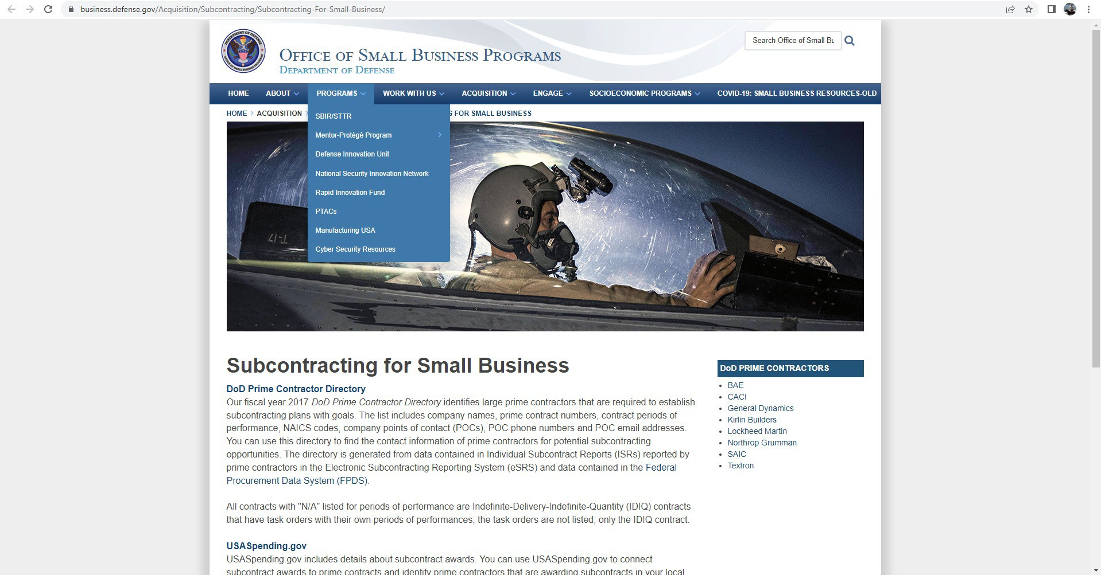
Notes:
Business.defense.gov is the reference
Click “Programs”- DOD Prime Contractor Directory…..

Slide 30
Berry and Kissell Agreements
Berry Amendment
Kissell Amendment
The Berry Amendment is a U.S. federal law that requires the Department of Defense (DoD) to give preference in procurement to domestically-produced, manufactured, or home-grown goods, including textiles and clothing.
Enacted in 1941, the Berry Amendment aimed to protect and support domestic industries, ensuring a stable and secure supply chain for critical goods needed for national defense.
The Kissell Amendment, introduced in 2009 and requires that textile and apparel items purchased by the Department of Homeland Security (DHS) for use by the Transportation Security Administration (TSA) be manufactured in the United States.
Notes:
Berry goes all the way back to the fiber!

Slide 31
Notes:
NCMBC.US is the website.

Slide 32
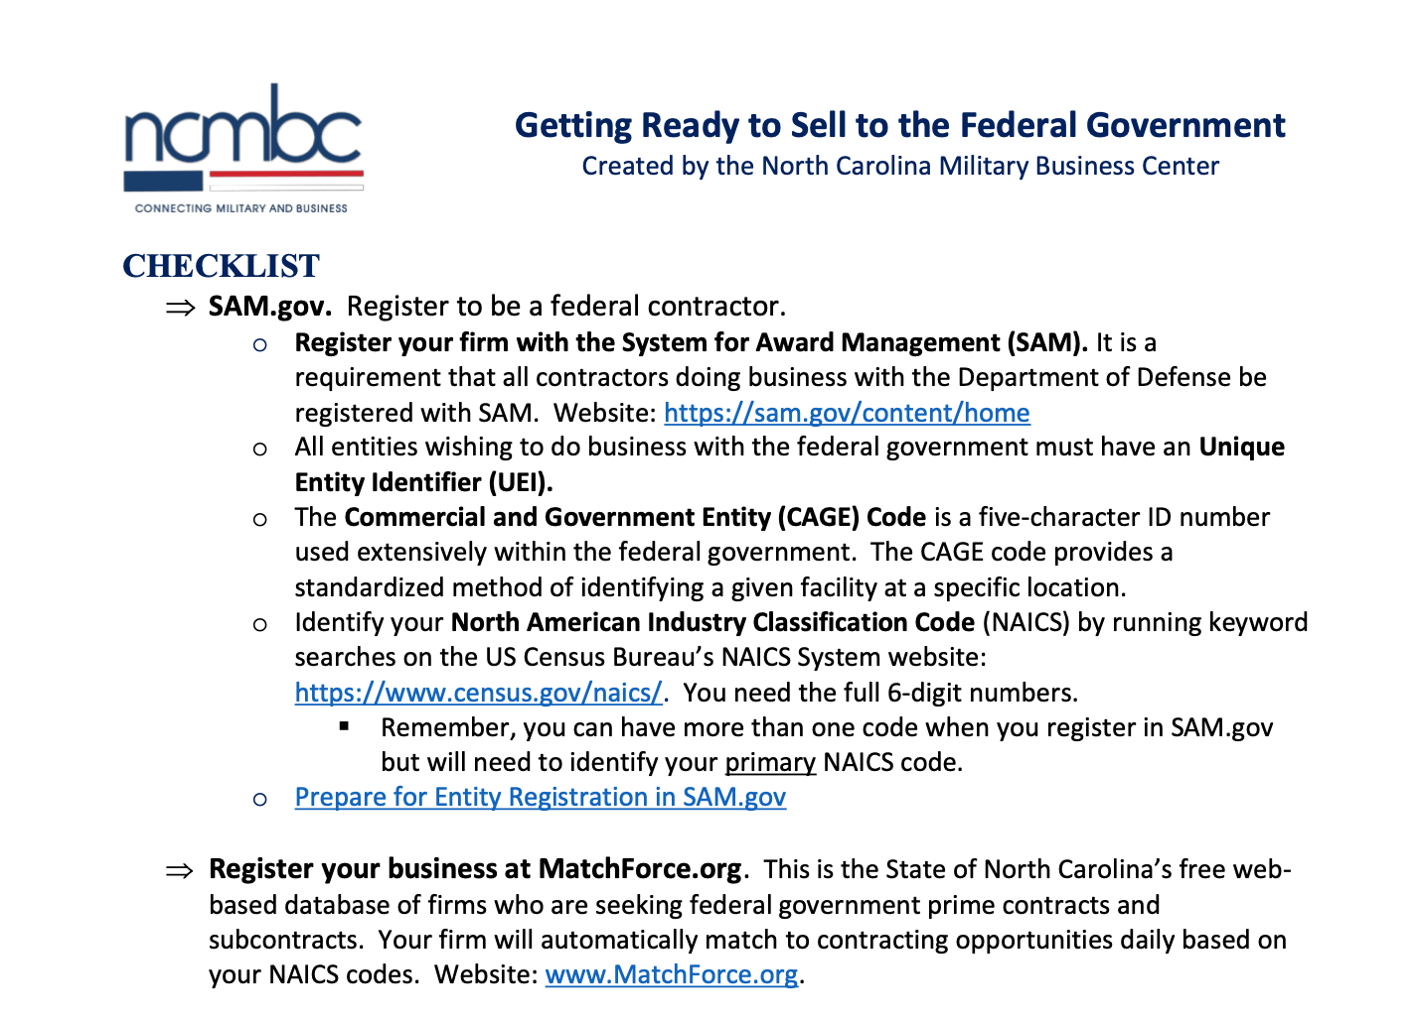
Notes:
Checklist on our Website……..good ready reference

Slide 33
Getting Started in the DoD Market
Help you accomplish missions, meet Directorate requirements
Drive competition, drive down costs, beat small business goals
Engage businesses to work for the military
Provide market intel, business development, training and one-on-one technical assistance (pre- and post-award)
Promote employment: transitioning military & families
Promote installation/command - community relations
Helpful Terms
EIN (Employer ID Number)- issued by IRS
UEI (Unique Entity ID) - assigned by SAM.gov (replaces DUNS)
PSC (Product Service Codes)
NAICS (North American Industry Classification System)
US Census Bureau- lookup NAICS
Determine if your firm qualifies for small business “Set Asides”
SAM.gov (System for Award Management)

Slide 34
Getting Started in the DoD Market
Help you accomplish missions, meet Directorate requirements
Drive competition, drive down costs, beat small business goals
Engage businesses to work for the military
Provide market intel, business development, training and one-on-one technical assistance (pre- and post-award)
Promote employment: transitioning military & families
Promote installation/command - community relations
Register in System for Award Management (www.SAM.gov)
SAM.gov is an official, free website of the U.S. government
Register to do federal contracting
Check status, update or renew (annually) entity registration
Search for entity registration and exclusion records
Registration in SAM.gov is mandatory before award of a contract vehicle! SAM Registration results in assignment of CAGE Code, this allows you to get paid!
SAM Entity Registration Checklist
SAM Entity Registration Checklist
Notes:
What is SAM.Gov?
Active Link to a Checklist- takes between 2-3 hours to register.

Slide 35
Getting Started in the DoD Market
Help you accomplish missions, meet Directorate requirements
Drive competition, drive down costs, beat small business goals
Engage businesses to work for the military
Provide market intel, business development, training and one-on-one technical assistance (pre- and post-award)
Promote employment: transitioning military & families
Promote installation/command - community relations
Identify your Product Service Code
Identify your Product Service Codes (4 Characters)
Acquisition.gov Product and Service Code Manual
Products: digit in first position
Services, R&D: letter in first position

Slide 36
Top Product Service Codes All States FY23
Help you accomplish missions, meet Directorate requirements
Drive competition, drive down costs, beat small business goals
Engage businesses to work for the military
Provide market intel, business development, training and one-on-one technical assistance (pre- and post-award)
Promote employment: transitioning military & families
Promote installation/command - community relations
FY23 Textiles Top PSC by Federal Award Amount
PSC | PSC DESCRIPTION | CONTRACT TOTAL
8465 | INDIVIDUAL EQUIPMENT | $111,608,971,634.41
8415 | CLOTHING, SPECIAL PURPOSE | $999,436,845.62
7110 | OFFICE FURNITURE | $791,922,801.62
8470 | ARMOR, PERSONAL | $505,095,816.84
8305 | TEXTILE FABRICS | $129,763,748.75
6530 | HOSPITAL FURNITURE, EQUIPMENT, UTENSILS, AND SUPPLIES | $372,850,449.45
8405 | OUTERWEAR, MEN'S | $268,644,649.57
Notes:
List NAICS code descriptions and separate this into two slides. Remove surgical numbers.

Slide 37
Textile (and Furniture) Industry Product Service Codes (PSCs)
Help you accomplish missions, meet Directorate requirements
Drive competition, drive down costs, beat small business goals
Engage businesses to work for the military
Provide market intel, business development, training and one-on-one technical assistance (pre- and post-award)
Promote employment: transitioning military & families
Promote installation/command - community relations
PSC | Description | PSC | Description
4240 | SAFETY AND RESCUE EQUIPMENT | 8345 | FLAGS AND PENNANTS
4720 | HOSE AND FLEXIBLE TUBING | 8405 | OUTERWEAR, MEN'S
6510 | SURGICAL DRESSING MATERIALS | 8410 | OUTERWEAR, WOMEN'S
6530 | HOSPITAL FURNITURE, EQUIPMENT, UTENSILS, AND SUPPLIES | 8415 | CLOTHING, SPECIAL PURPOSE
6532 | HOSPITAL AND SURGICAL CLOTHING AND RELATED SPECIAL PURPOSE ITEMS | 8420 | UNDERWEAR AND NIGHTWEAR, MEN'S
7105 | HOUSEHOLD FURNITURE | 8425 | UNDERWEAR AND NIGHTWEAR, WOMEN'S
7110 | OFFICE FURNITURE | 8430 | FOOTWEAR, MEN'S
7195 | MISCELLANEOUS FURNITURE AND FIXTURES | 8435 | FOOTWEAR, WOMEN'S
7210 | HOUSEHOLD FURNISHINGS | 8440 | HOSIERY, HANDWEAR, AND CLOTHING ACCESSORIES, MEN'S
8105 | BAGS AND SACKS | 8445 | HOSIERY, HANDWEAR, AND CLOTHING ACCESSORIES, WOMEN'S
8305 | TEXTILE FABRICS | 8450 | CHILDREN'S AND INFANTS' APPAREL AND ACCESSORIES
8310 | YARN AND THREAD | 8455 | BADGES AND INSIGNIA
8315 | NOTIONS AND APPAREL FINDINGS | 8460 | LUGGAGE
8320 | PADDING AND STUFFING MATERIALS | 8465 | INDIVIDUAL EQUIPMENT
8325 | FUR MATERIALS | 8470 | ARMOR, PERSONAL
8330 | LEATHER | 8475 | SPECIALIZED FLIGHT CLOTHING AND ACCESSORIES
8335 | SHOE FINDINGS AND SOLING MATERIALS | 9410 | CRUDE GRADES OF PLANT MATERIALS
8340 | TENTS AND TARPAULINS | 9420 | FIBERS: VEGETABLE, ANIMAL, AND SYNTHETIC
Notes:
Add PSC Descriptions – remove surgical PSC Codes.

Slide 38
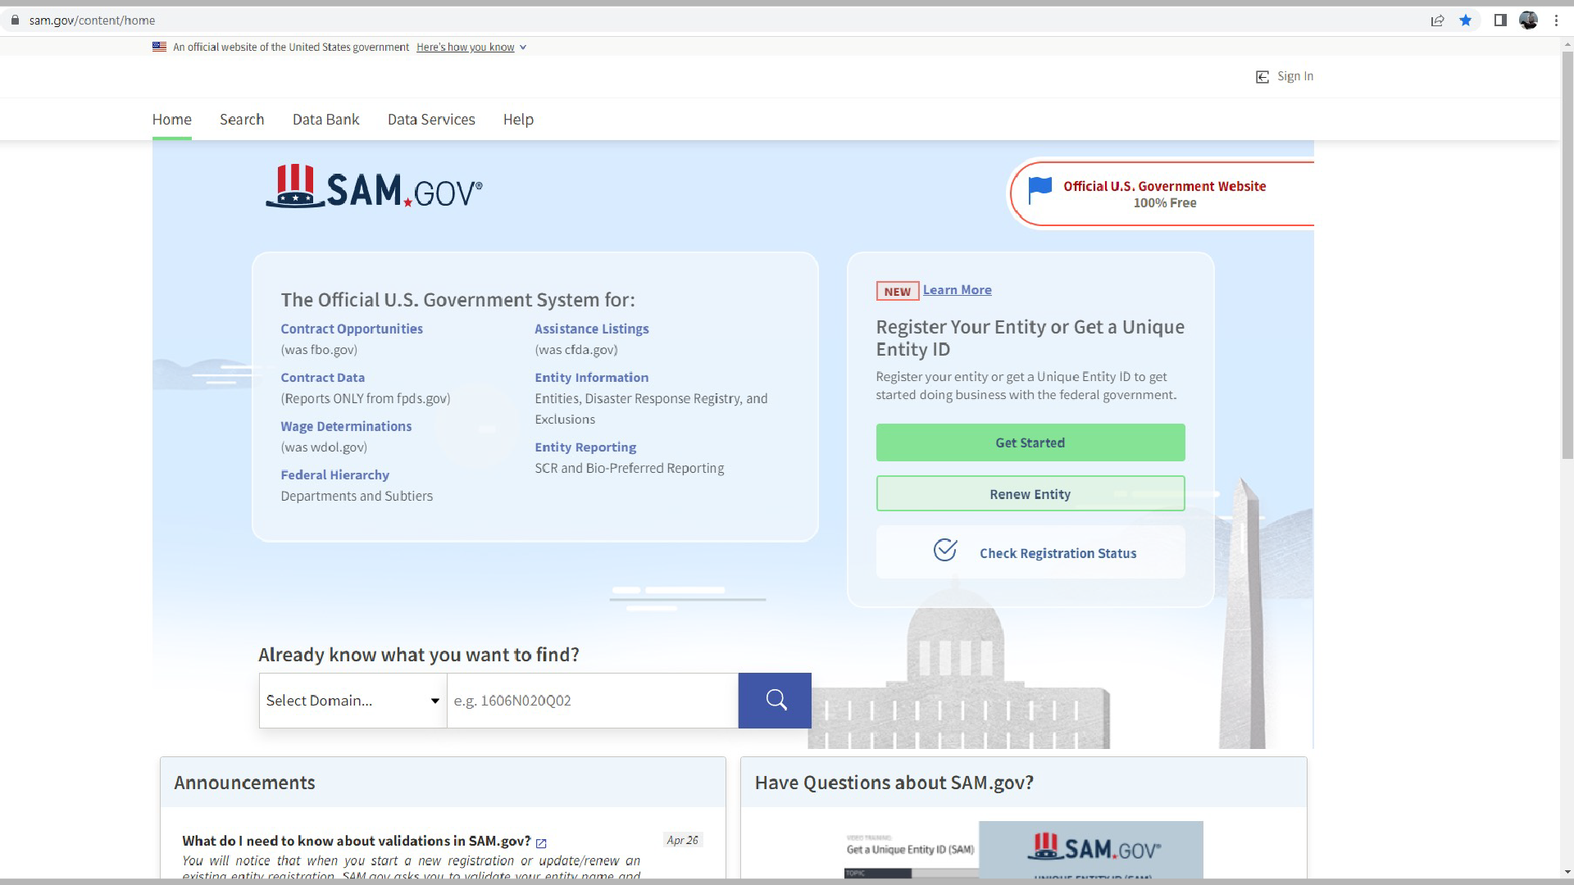
Notes:
Here is the landing page- pretty simple website to navigate.

Slide 39
SAM Contract Opportunity Notices Types of Opportunities
Help you accomplish missions, meet Directorate requirements
Drive competition, drive down costs, beat small business goals
Engage businesses to work for the military
Provide market intel, business development, training and one-on-one technical assistance (pre- and post-award)
Promote employment: transitioning military & families
Promote installation/command - community relations
Reference
SAM Contract Opportunity Notice Types
Notes:
Maybe one (or two) slide(s) that briefly describe(s) each type of notice
Wouldn’t spend much time on it
https://www.fsd.gov/gsafsd_sp?id=gsafsd_kb_articles&sys_id=1807b0651bdaed100ca4a97ae54bcb67
Provides all 9 contract opportunity notice types available in SAM.gov
Recommend responding to sources sought and presolicitations because they are trying to determine an acquisition strategy which may include making it a small business set-aside
Also an opportunity to help “shape” the procurement

Slide 40
Sources Sought
Help you accomplish missions, meet Directorate requirements
Drive competition, drive down costs, beat small business goals
Engage businesses to work for the military
Provide market intel, business development, training and one-on-one technical assistance (pre- and post-award)
Promote employment: transitioning military & families
Promote installation/command - community relations
A request for information (RFI), or a solicitation of interest
Helps an agency understand the interests and capabilities of businesses that would submit proposals for a future contract
May or may not be followed by a solicitation
Very important to respond - the government is trying to determine a vendor source
Notes:
Pay Attention and Respond

Slide 41
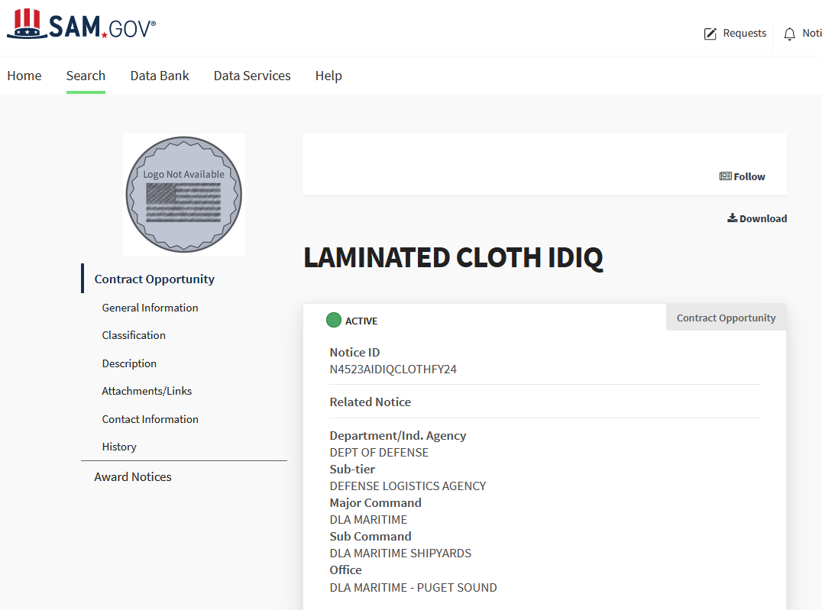
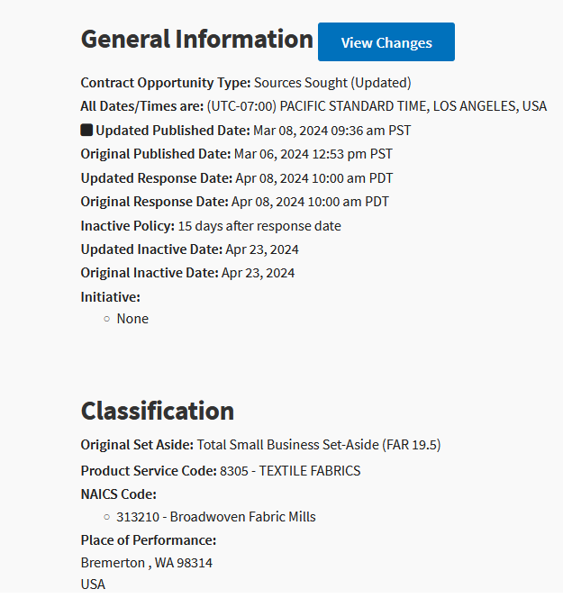
Sources Sought Example

Slide 42
Pre-Solicitation Notice
Help you accomplish missions, meet Directorate requirements
Drive competition, drive down costs, beat small business goals
Engage businesses to work for the military
Provide market intel, business development, training and one-on-one technical assistance (pre- and post-award)
Promote employment: transitioning military & families
Promote installation/command - community relations
A notice that a contract opportunity will open in the future
May ask interested businesses to submit information to help the agency determine whether the contract should be reserved for businesses that qualify for certain types of set-asides.
Very important to respond – government is trying to shape the requirement

Slide 43
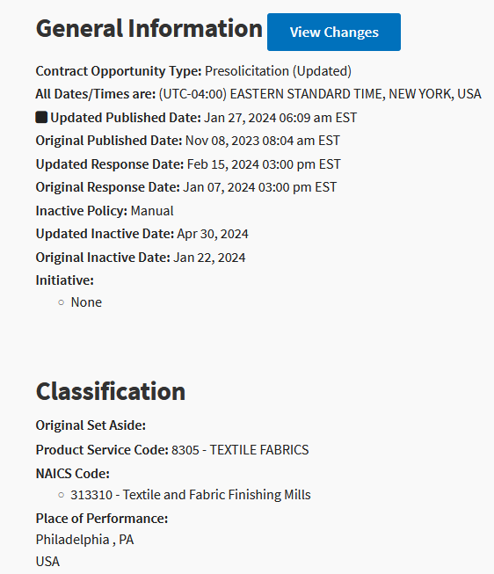
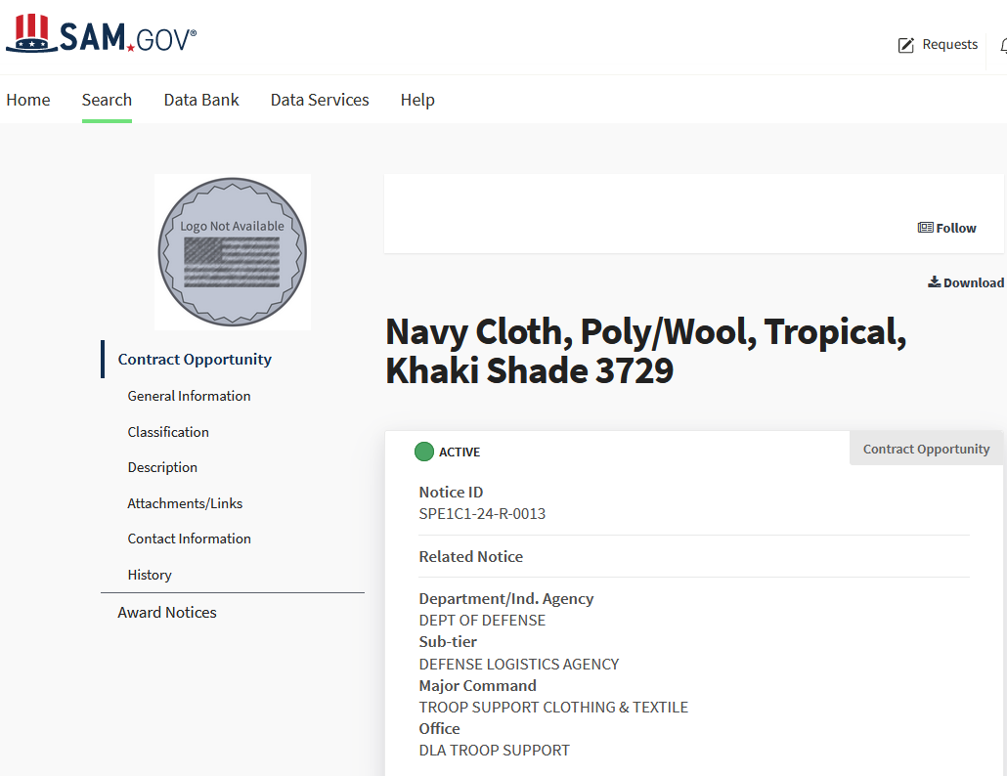
Pre-Solicitation Example

Slide 44
Solicitation
Help you accomplish missions, meet Directorate requirements
Drive competition, drive down costs, beat small business goals
Engage businesses to work for the military
Provide market intel, business development, training and one-on-one technical assistance (pre- and post-award)
Promote employment: transitioning military & families
Promote installation/command - community relations
Request to submit offers or quotations to the government
Solicitations under sealed bid procedures are called “invitations for bids”
Solicitations under negotiated procedures are called “requests for proposals”
Solicitations under simplified acquisition procedures may require submission of either a quotation or an offer.
Watch the “due date” and answer all/only the USG questions!

Slide 45
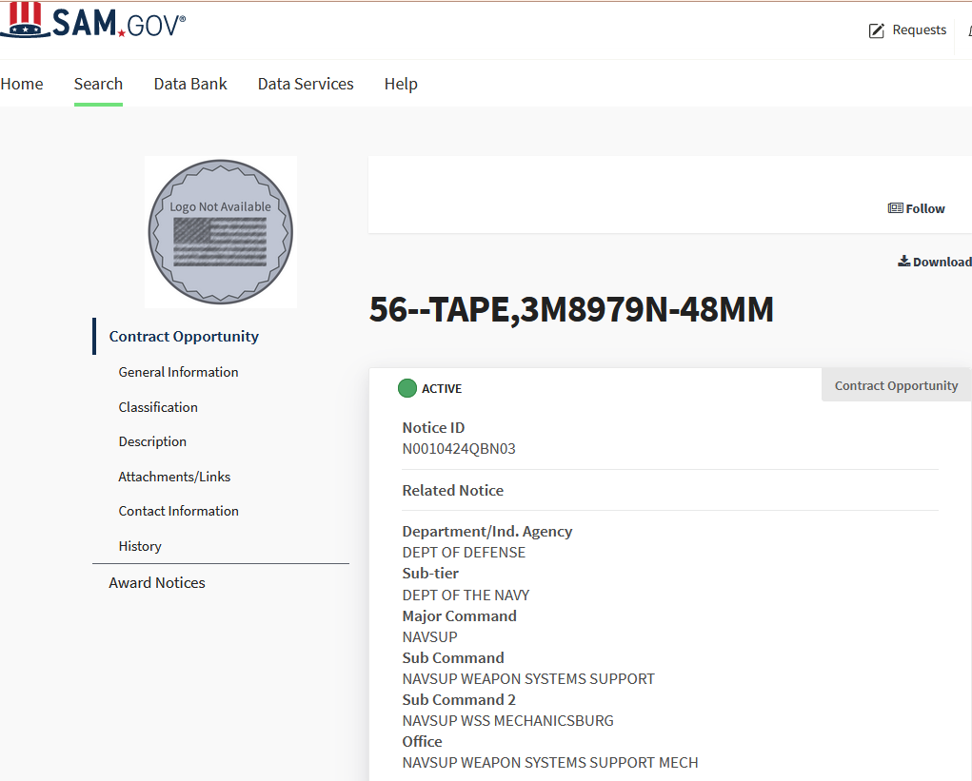
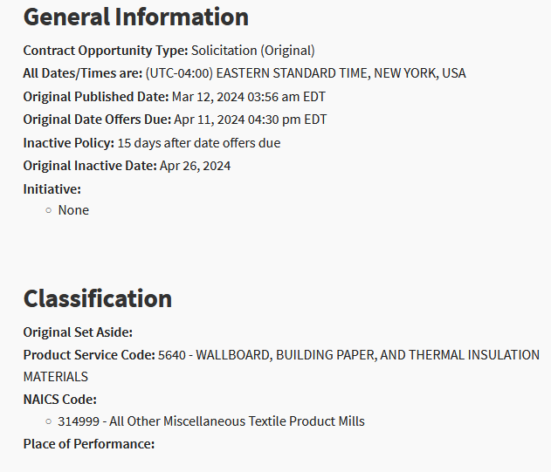
Solicitation

Slide 46
Combined Synopsis/Solicitation
Help you accomplish missions, meet Directorate requirements
Drive competition, drive down costs, beat small business goals
Engage businesses to work for the military
Provide market intel, business development, training and one-on-one technical assistance (pre- and post-award)
Promote employment: transitioning military & families
Promote installation/command - community relations
A combination of a synopsis of an opportunity and the solicitation for that opportunity
Used for commercial items to streamline the acquisition process

Slide 47
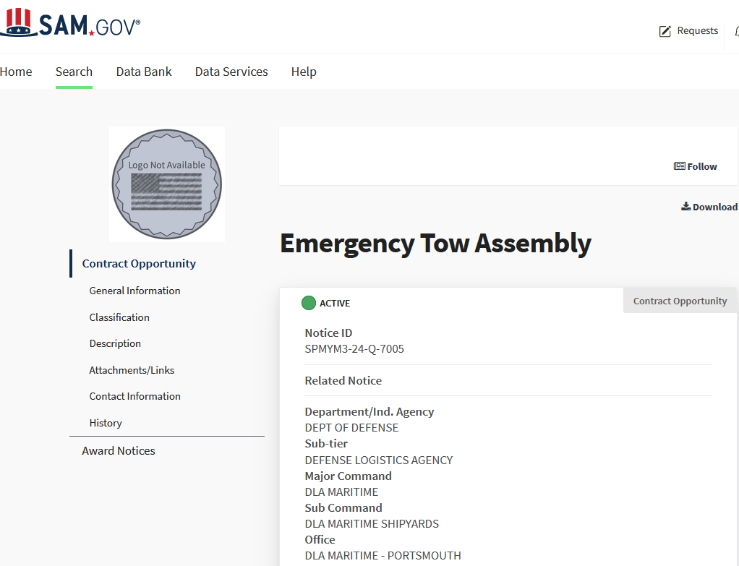
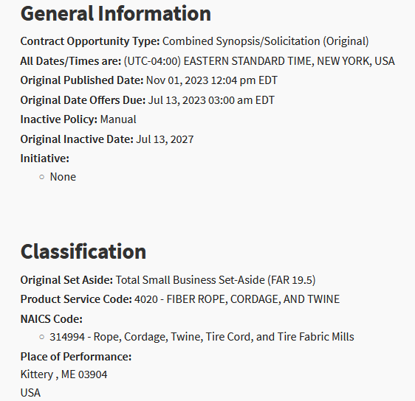
Combined Synopsis/Solicitation

Slide 48
Finding Opportunities and Next Steps “Quick Review”
Help you accomplish missions, meet Directorate requirements
Drive competition, drive down costs, beat small business goals
Engage businesses to work for the military
Provide market intel, business development, training and one-on-one technical assistance (pre- and post-award)
Promote employment: transitioning military & families
Promote installation/command - community relations
Become web-enabled to find contracts
Learn the basic rules of contracting
Learn to describe your business and your products/services (UEI, NAICS, CAGE and PSC codes)
Develop marketing materials and capabilities statements: in “government speak”
Follow the checklist on www.ncmbc.us!
Register: www.MatchForce.org, SAM.gov

Slide 49
Finding Opportunities and Next Steps Quick Review- continued
Help you accomplish missions, meet Directorate requirements
Drive competition, drive down costs, beat small business goals
Engage businesses to work for the military
Provide market intel, business development, training and one-on-one technical assistance (pre- and post-award)
Promote employment: transitioning military & families
Promote installation/command - community relations
Certify with any Small Business Administration (SBA) for Contracting Program “Set-Asides”
Monitor Opportunities: SAM.gov, MatchForce.org, etc.
Respond to opportunities, including…. Sources Sought and Requests for Information
Network with prime contractors for subcontract opportunities
Leverage free state resources – Join networks/connecting organizations (DANC), NC State IES, use NCMBC/SBTDC/SBA/SBC and attend EVENTS!
Play the Long Game!
Notes:
The next slide shows you a typical SAM.GOV search

Slide 50
Textile Networking & Learning Opportunities
Help you accomplish missions, meet Directorate requirements
Drive competition, drive down costs, beat small business goals
Engage businesses to work for the military
Provide market intel, business development, training and one-on-one technical assistance (pre- and post-award)
Promote employment: transitioning military & families
Promote installation/command - community relations
Plan to Attend! - Federal and Defense Textile Summit, FEDTEX
(14-15 MAY 2024, McKimmon Center, Raleigh NC) See NCMBC.us for details.
Notes:
Last But not Least- NETWORK

Slide 51
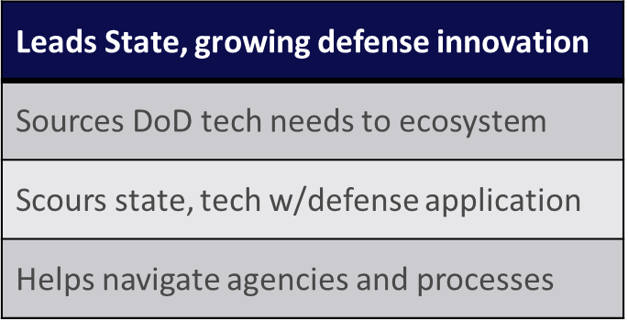
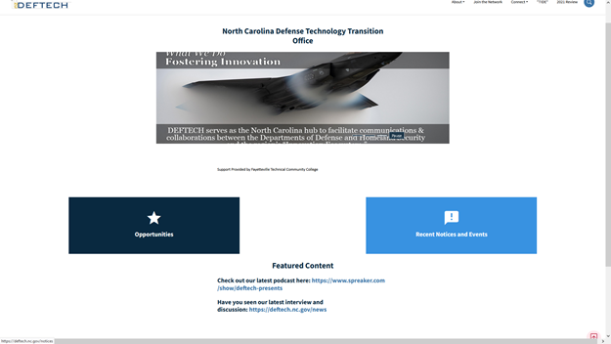
Technology Transition (DEFTECH)
CY2016-CY2023 | Opportunities distributed: over 1,400 | Innovation events: 100+
Innovation Awards: over $20 million, min value

Slide 52
Tech Transition (DEFTECH)
CSM (Ret.) DEFTECH Interim Director (RAL) Bob Burton Email: burtonb@ncmbc.us O: 910.824.9609

Slide 53
Finding Opportunities and Next Steps “References”
Help you accomplish missions, meet Directorate requirements
Drive competition, drive down costs, beat small business goals
Engage businesses to work for the military
Provide market intel, business development, training and one-on-one technical assistance (pre- and post-award)
Promote employment: transitioning military & families
Promote installation/command - community relations
NCMBC.us
MatchForce.org
SAM.gov
SBA Federal Contracting Guide
Federal Procurement Data System
USASpending.gov
Notes:
Active References- Last Slide.

Slide 54
NCMBC Textiles BD Team
Lee Moritz | TJ Gilroy
Federal Business Development (Hickory) E: moritzl@ncmbc.us C: 828-446-7193 | Federal Business Development (Southern Pines) E: gilroyt@ncmbc.us

